Slide 1
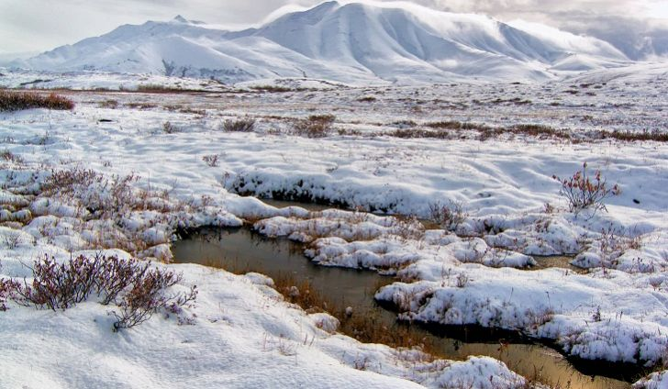
Tundra

Slide 2
Tundra
The tundra is one of the harshest habitats and it is the coldest! Temperatures in the tundra can reach as low as -25 degrees Fahrenheit! Beneath the tundra is permafrost. Permafrost is a permanently frozen layer of soil. There is very little rain or snow in the tundra, usually less than 15 inches a year. There are two types of tundra, the arctic and the alpine tundra. The arctic tundra is the land around the North Pole. The alpine tundra is found above the tree line of tall, cold mountains. Tundra covers 20% of the Earth's surface.

Slide 3
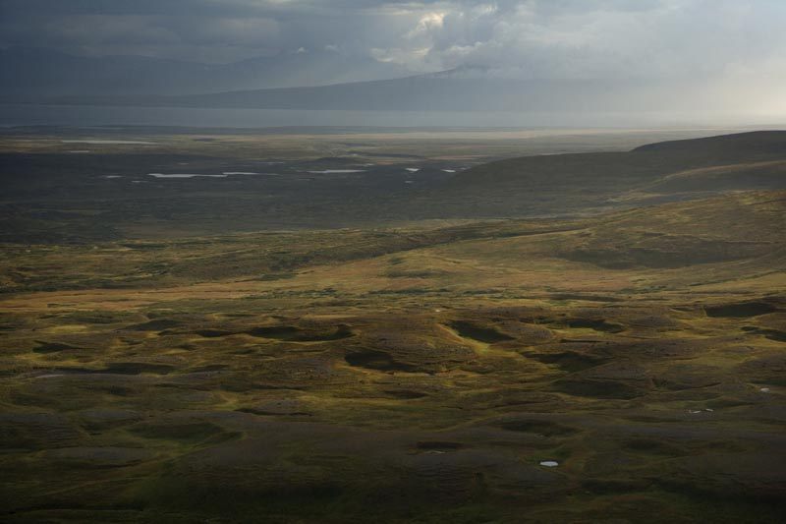
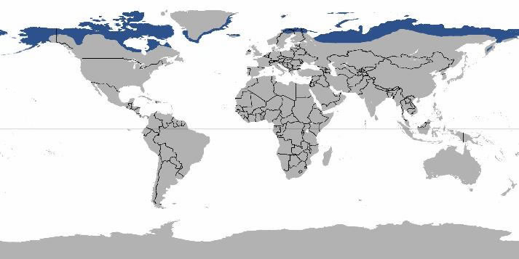
Tundra
Summers are very short and cool, lasting only about 6 to 10 weeks and the winters are very long and very cold. In the winter, there is minimal daylight as the sun barely rises. Summer and winter are the Tundra's 2 main seasons.

Slide 4
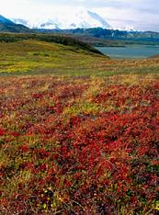
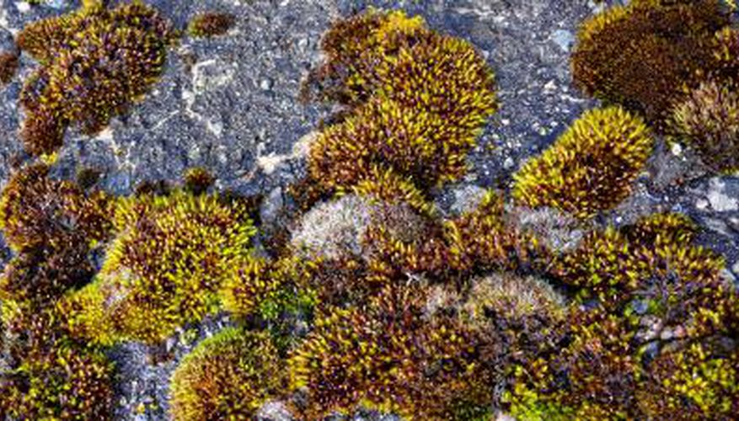
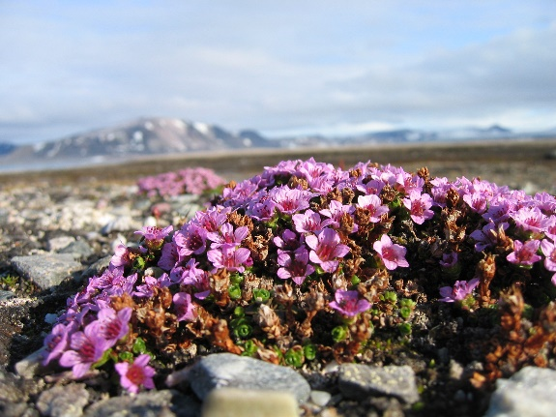
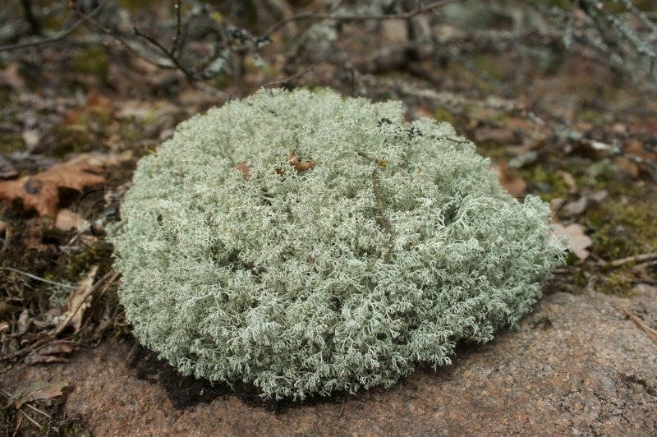
Tundra - Plants
Tundra means ‘treeless’, so most of the plants in the tundra are low growing plants.
Arctic Moss
Arctic Willow
Caribou Moss
Labrador Tea
Arctic Poppy
Cotton Grass
Lichens
Moss
Plants grow close together, low to the ground and are small. Many plants have a wax type of fuzzy, hairy coating on them which helps protect them from the cold and wind. This coating also helps them retain heat and moisture, and protects the plant seeds to for reproduction.

Slide 5
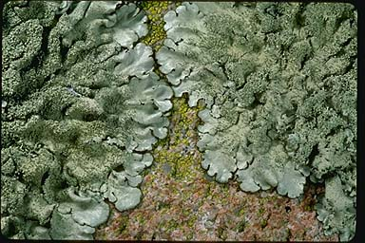
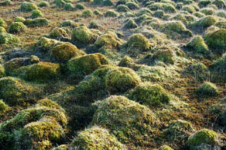
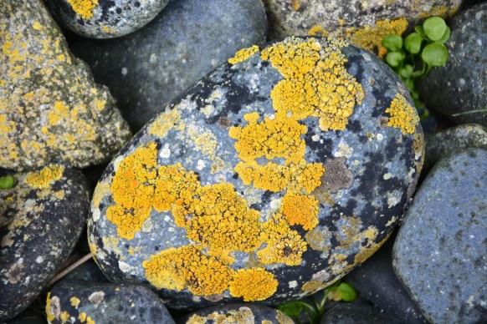
Tundra – Plants & Adaptations
Plants found here usually have small leaves, which helps the plants to retain moisture. Only the top layer of soil thaws out in the tundra, so the plants have very shallow root systems. Plants like lichens and moss can survive on bare rock with a bit of moisture. Most of the plants in the tundra are perennials and don’t die off in the winter. They have long life cycles to help with the short growing season.

Slide 6
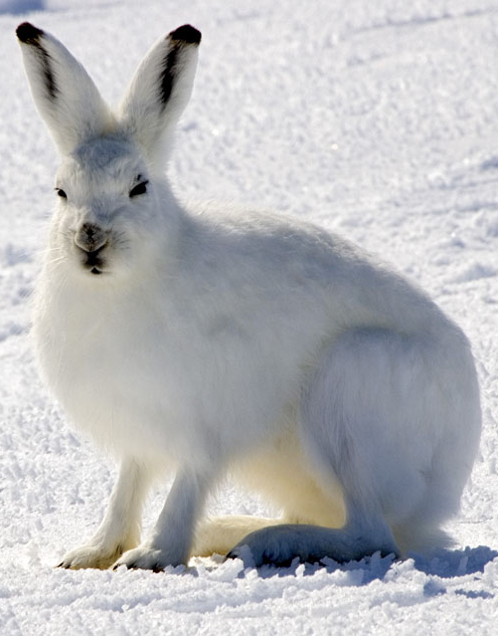
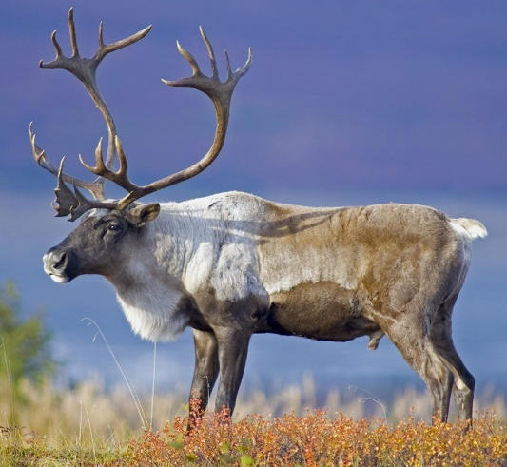
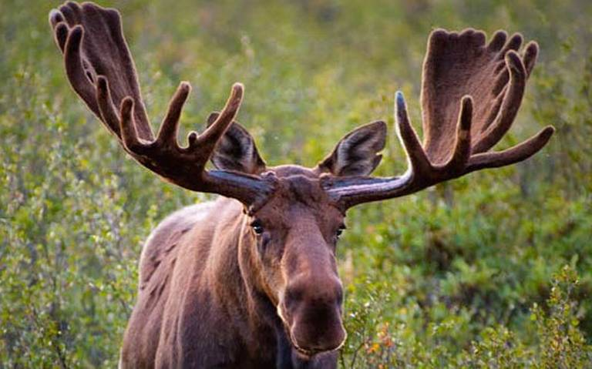
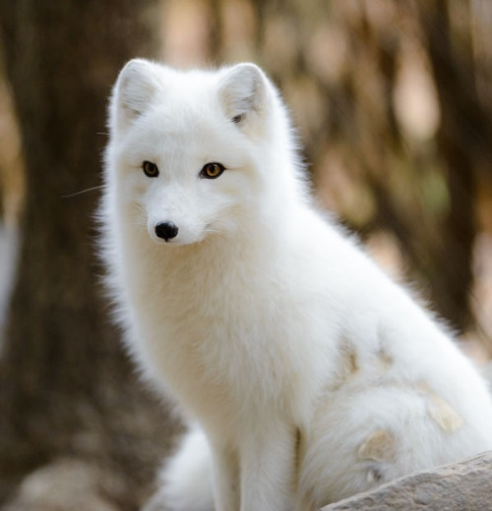
Tundra – Animals & Adaptations
Animals have many adaptations to survive in this harsh environment. Animals need shelter and insulation in the tundra. The animals here have thicker and warmer feathers and fur. Many of them have larger bodies and shorter arms, legs and tails which helps them retain their heat better and prevent heat loss. Many of the birds of the tundra have two coats of feathers to help keep them warm.

Slide 7
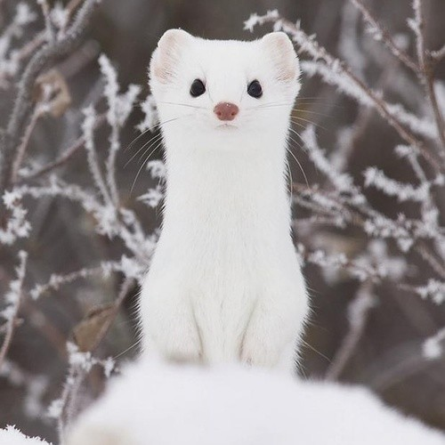
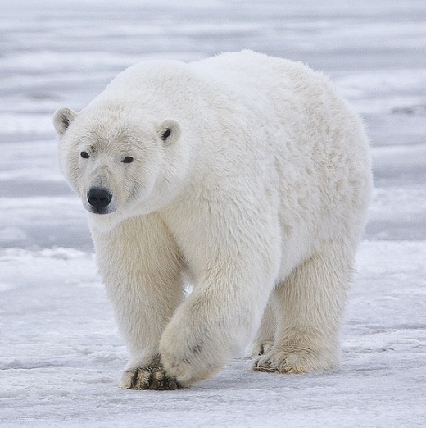
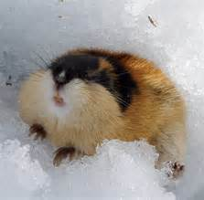
Tundra – Animals & Adaptations
Many animals of the tundra have feet that are lined with fur to help keep them warm. Some of the animals of the tundra (bears, marmot, arctic squirrels) will hibernate for the winter and others will burrow (lemmings, ermine). Many of the insects will spend their entire life buried in the soil, rocks or plants which acts as a shelter for them.

Slide 8
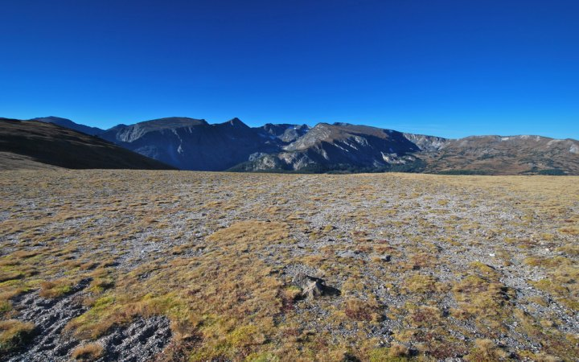

Slide 9
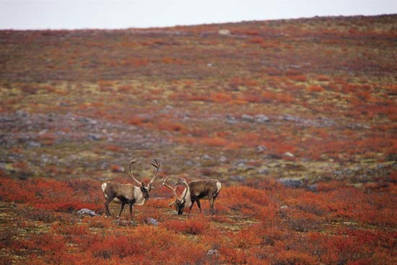

Slide 10
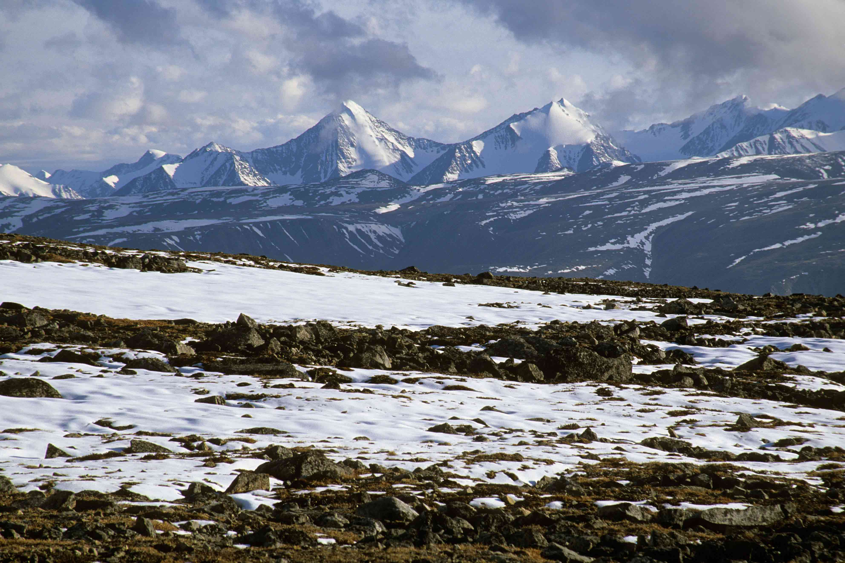

Slide 11
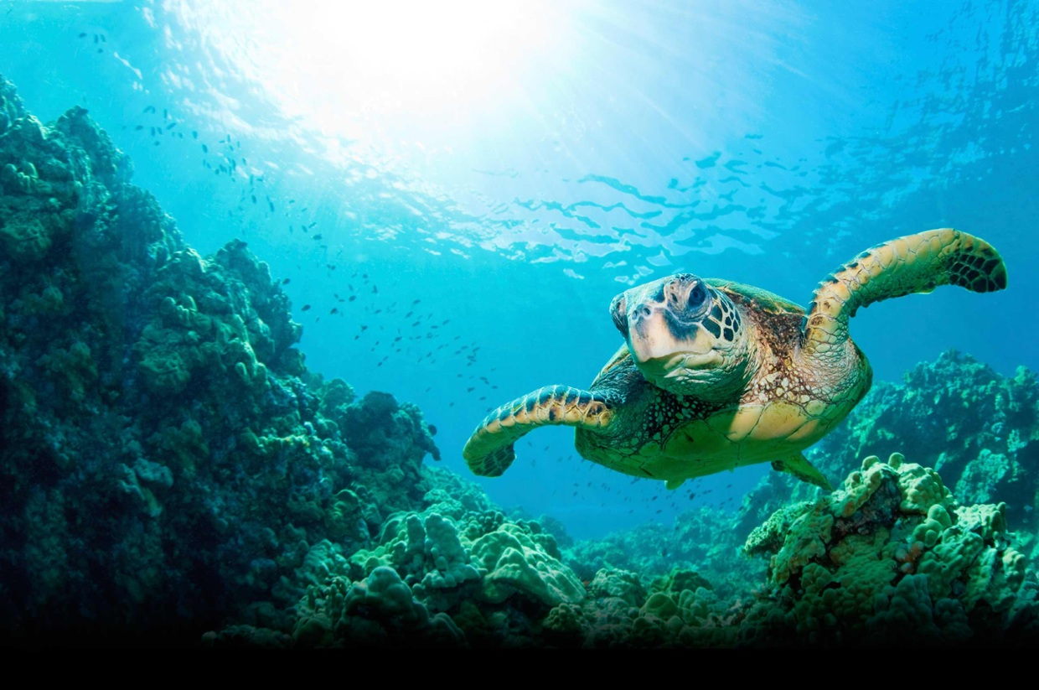
Ocean

Slide 12
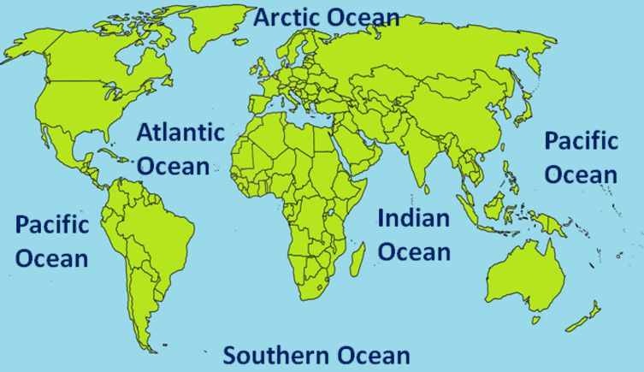
Ocean
The oceans hold about 96.5% of all of Earth’s water. Around 70% of the Earth’s surface is covered by 5 oceans. The largest ocean on Earth is the Pacific Ocean, covering around 30% of the Earth’s surface. The longest mountain range in the world is found under water. Stretching over 56,000km, the Mid-Oceanic Ridge is a mountain chain that runs along the center of the ocean basins.

Slide 13
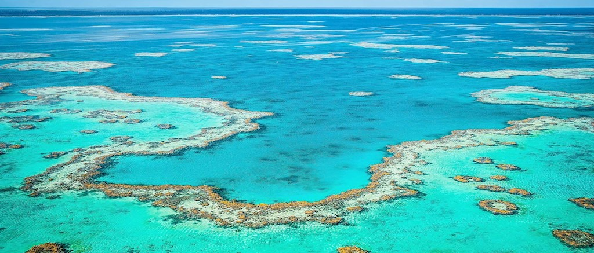
Ocean
The sea is home to the world’s largest living structure – the Great Barrier Reef. Measuring around 2,600km, it can even be seen from the Moon! We have only explored about 5% of the world’s oceans.

Slide 14
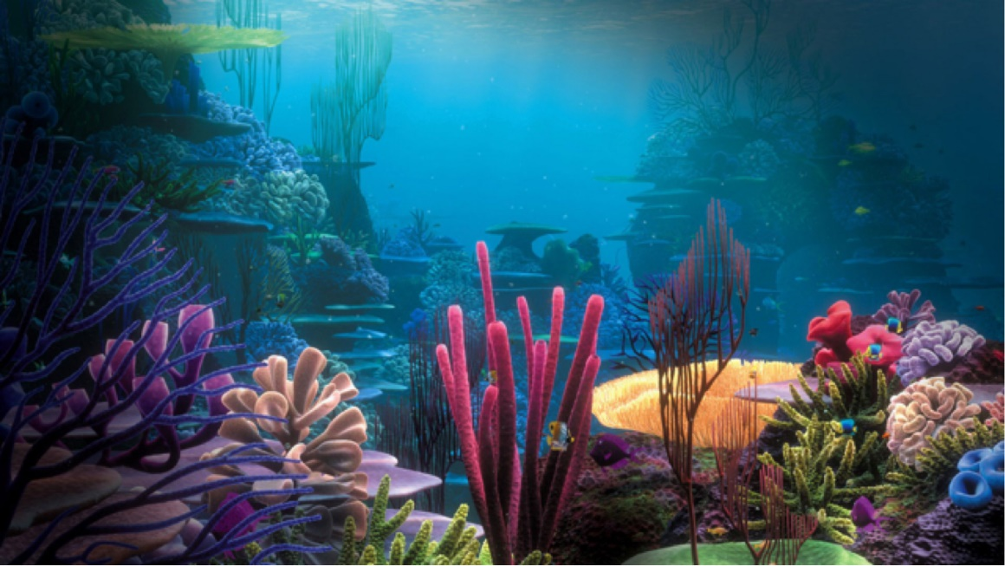
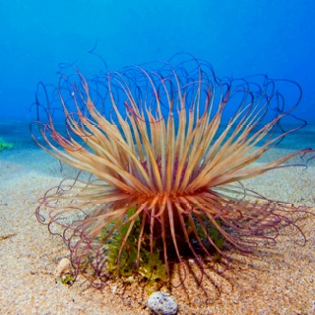
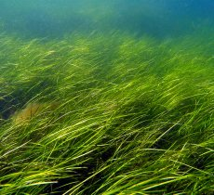
Ocean - Plants
Most of the ocean's plant life consists of microscopic algae called phytoplankton that float at the surface. Seaweed and kelp are big algae easily visible to the naked eye. Marine plants with roots, like seagrasses, can only survive as deep as the sun’s rays can support photosynthesis.

Slide 15
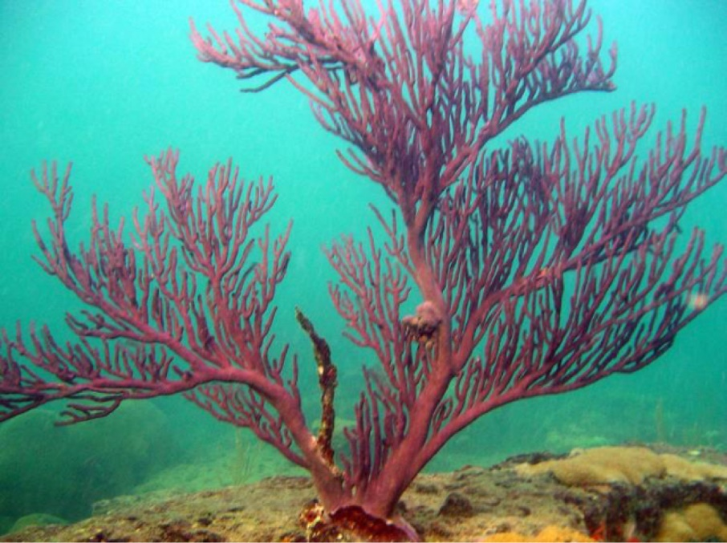
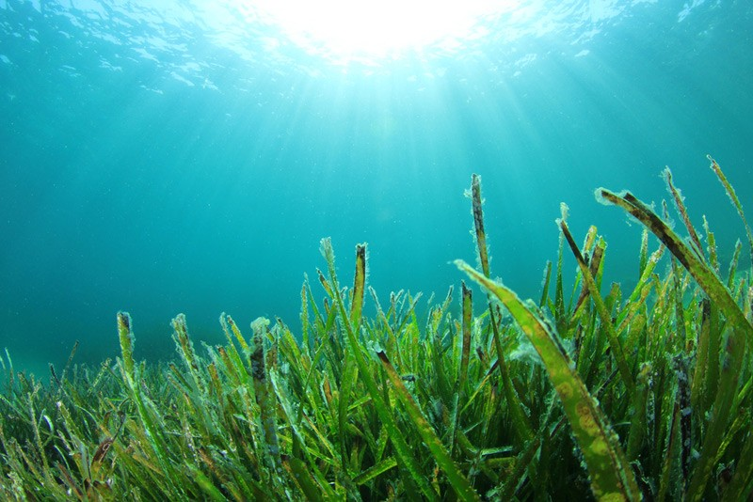
Ocean – Plants & Adaptations
Ocean plants have adapted to the salt by breaking down salt into chlorine and sodium ions. Some plants store the salt and later get rid of it in the air. Marine plants and algae attach firmly to rocks and other things, so waves don't wash them away. Certain seaweeds are tough and leathery, this protects them from being torn or dried out by the sun.

Slide 16
Ocean - Animals
Tube worms, clams, and mussels gather around vents to feed on heat-loving bacteria. Bizarre fish with sensitive eyes, translucent fangs, and bioluminescent lures lurk about in deep waters. Other fish, octopuses, squid, eels, dolphins, and whales swim through the open waters while crabs, lobsters, starfish, oysters, and snails crawl and scoot along the ocean bottom. Creatures like jellyfish can’t get around well on their own and rely on wind and currents. Mammals like otters, walruses, and even polar bears also depend on the ocean for their survival and dip in and out as they need to.

Slide 17
Ocean – Animals & Adaptations
There are 120 species of mammals including whales, dolphins, porpoises, seals and sea lions which have evolved to adapt to their aquatic environment by developing small appendages (ears and flippers), a generally large size, sleek body shapes and different methods to cope with extreme changes in temperature. Fish can drink saltwater and eliminate the salt through their gills. Crocodiles living in saltwater have adapted by developing special glands in their tongues to help them excrete salt.

Slide 18
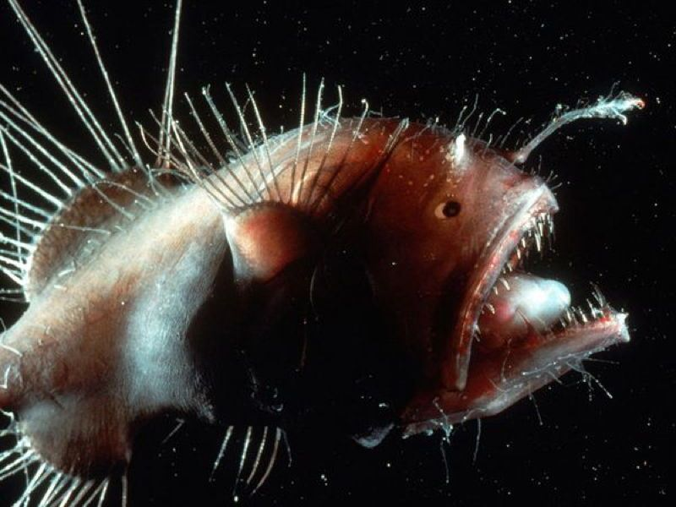
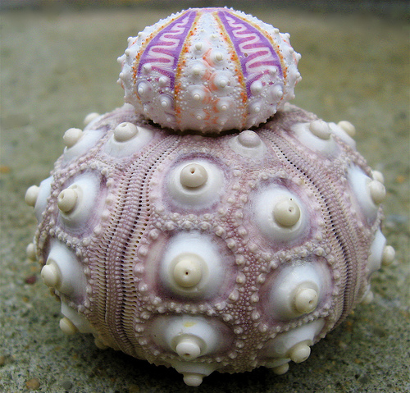
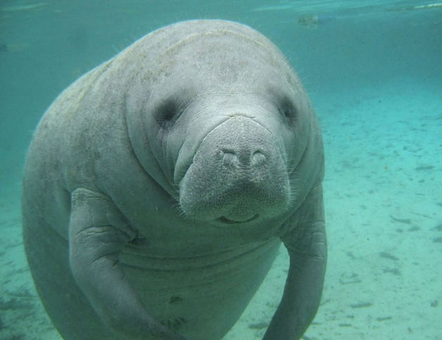
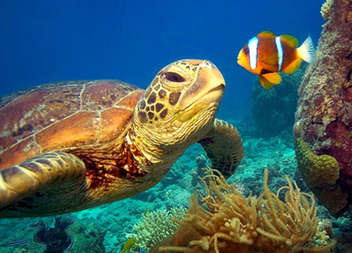
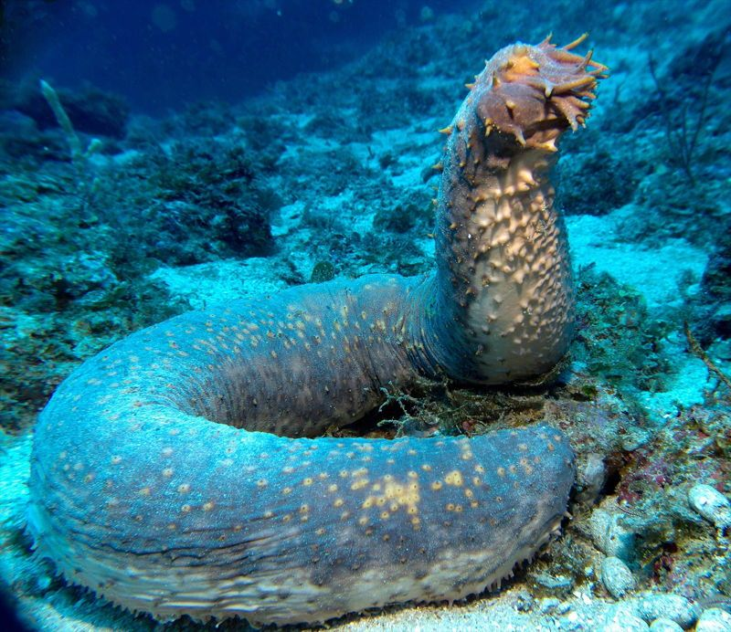
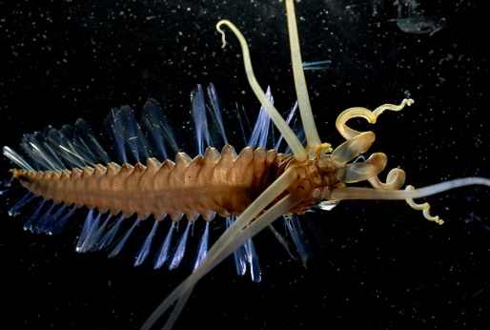
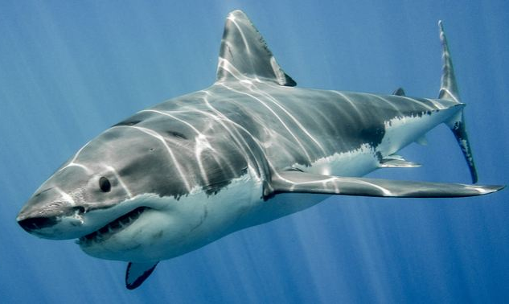
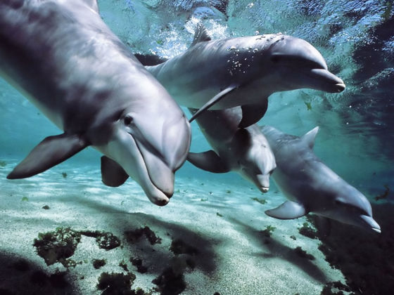
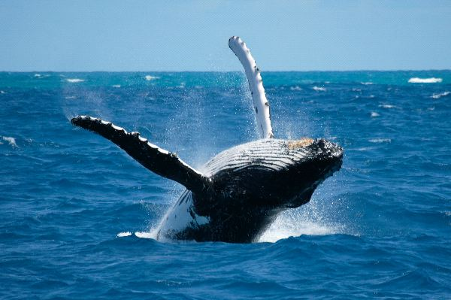
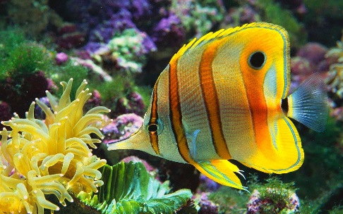
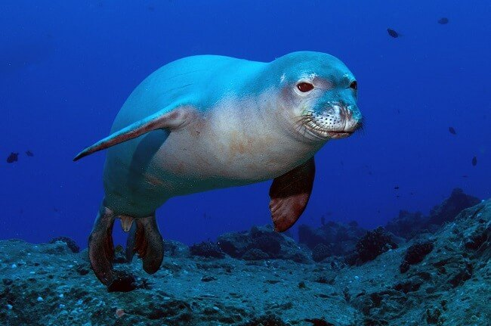
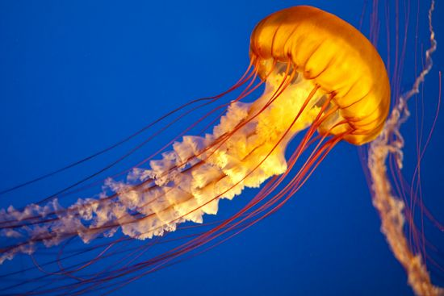
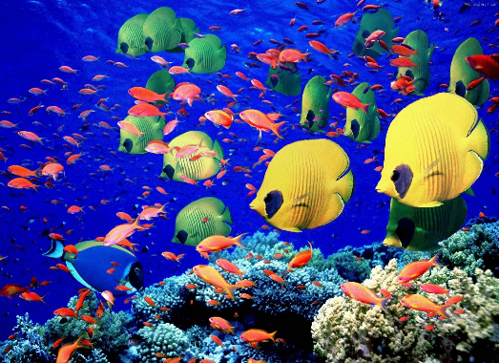
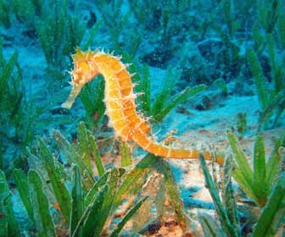

Slide 19
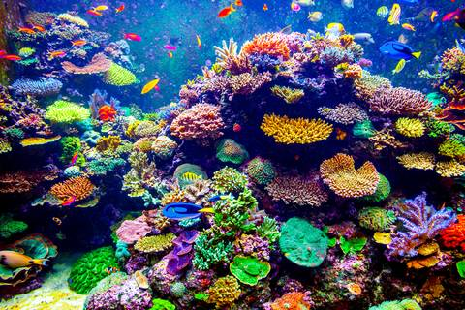

Slide 20
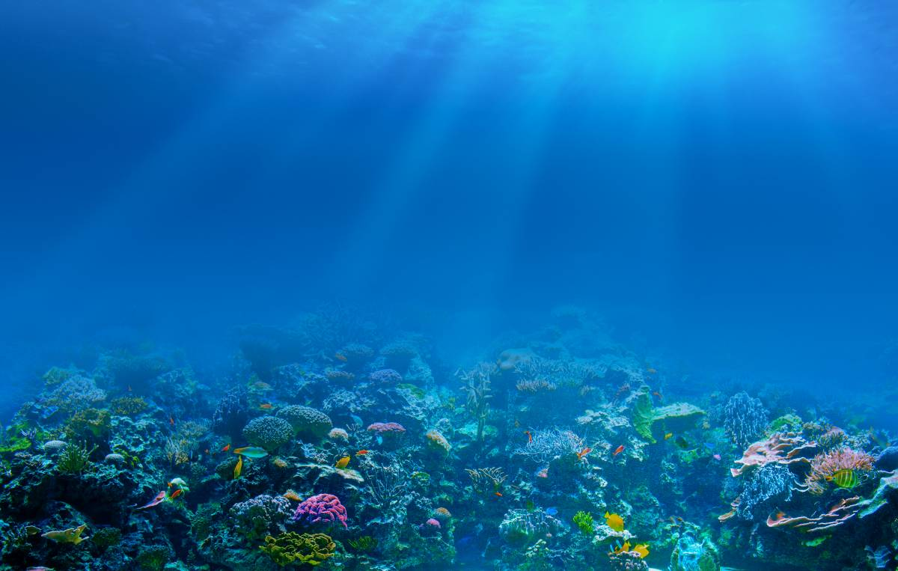

Slide 21
